Slide 1
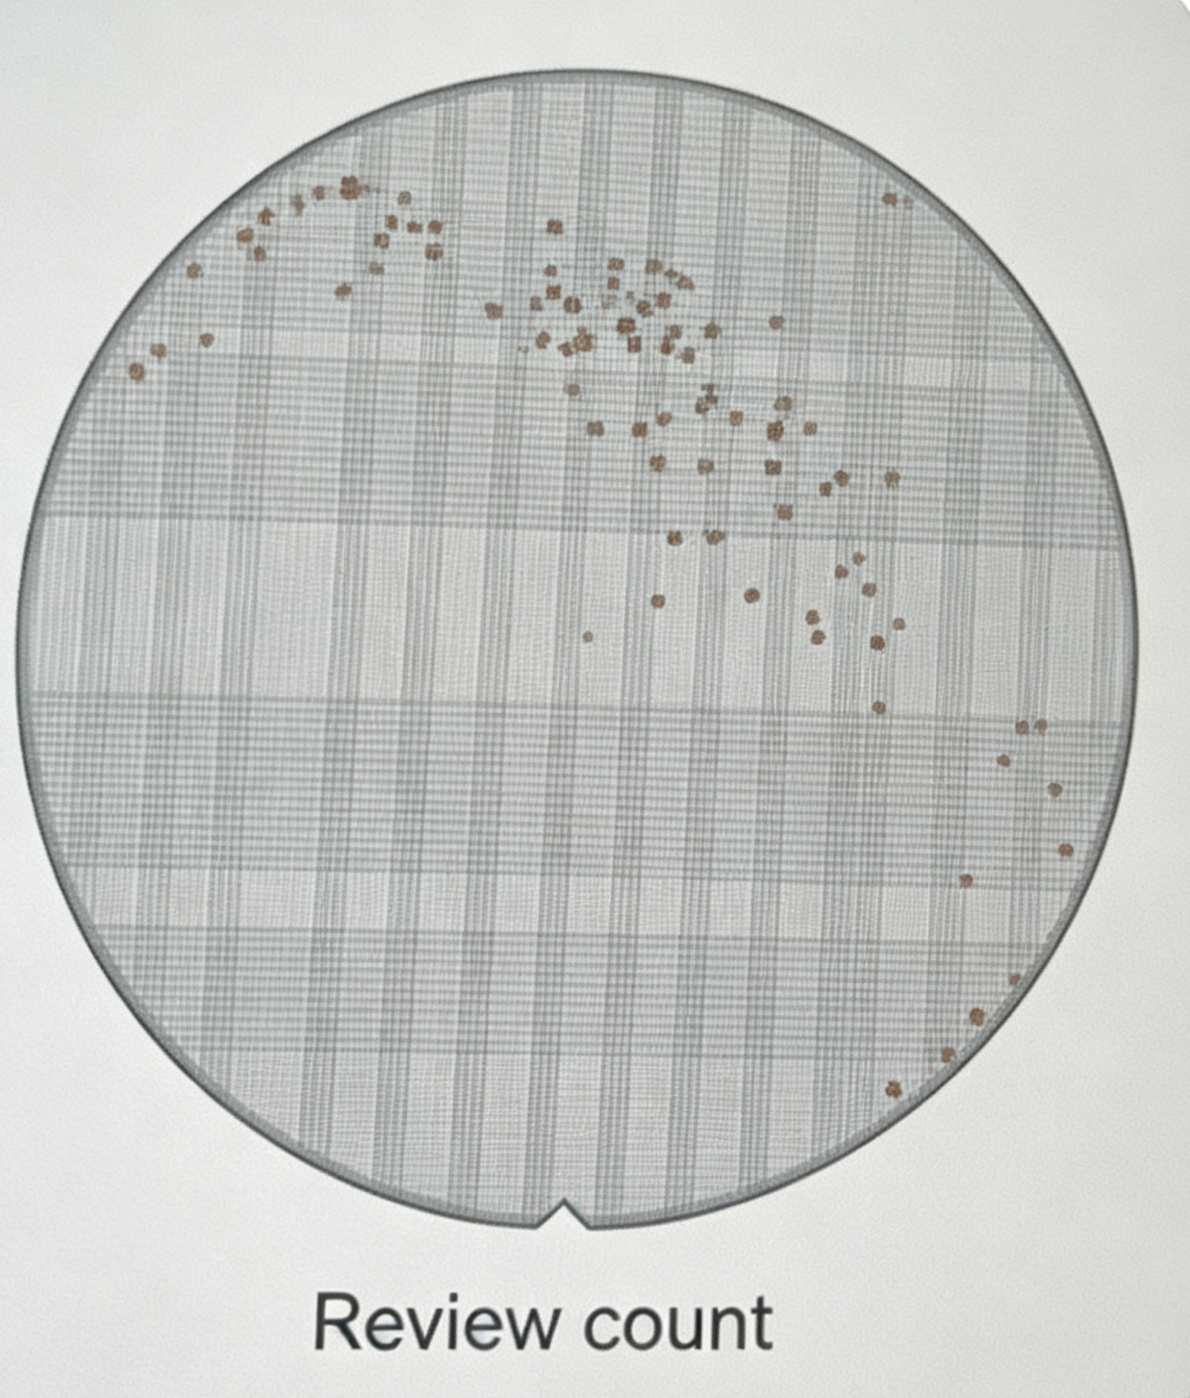
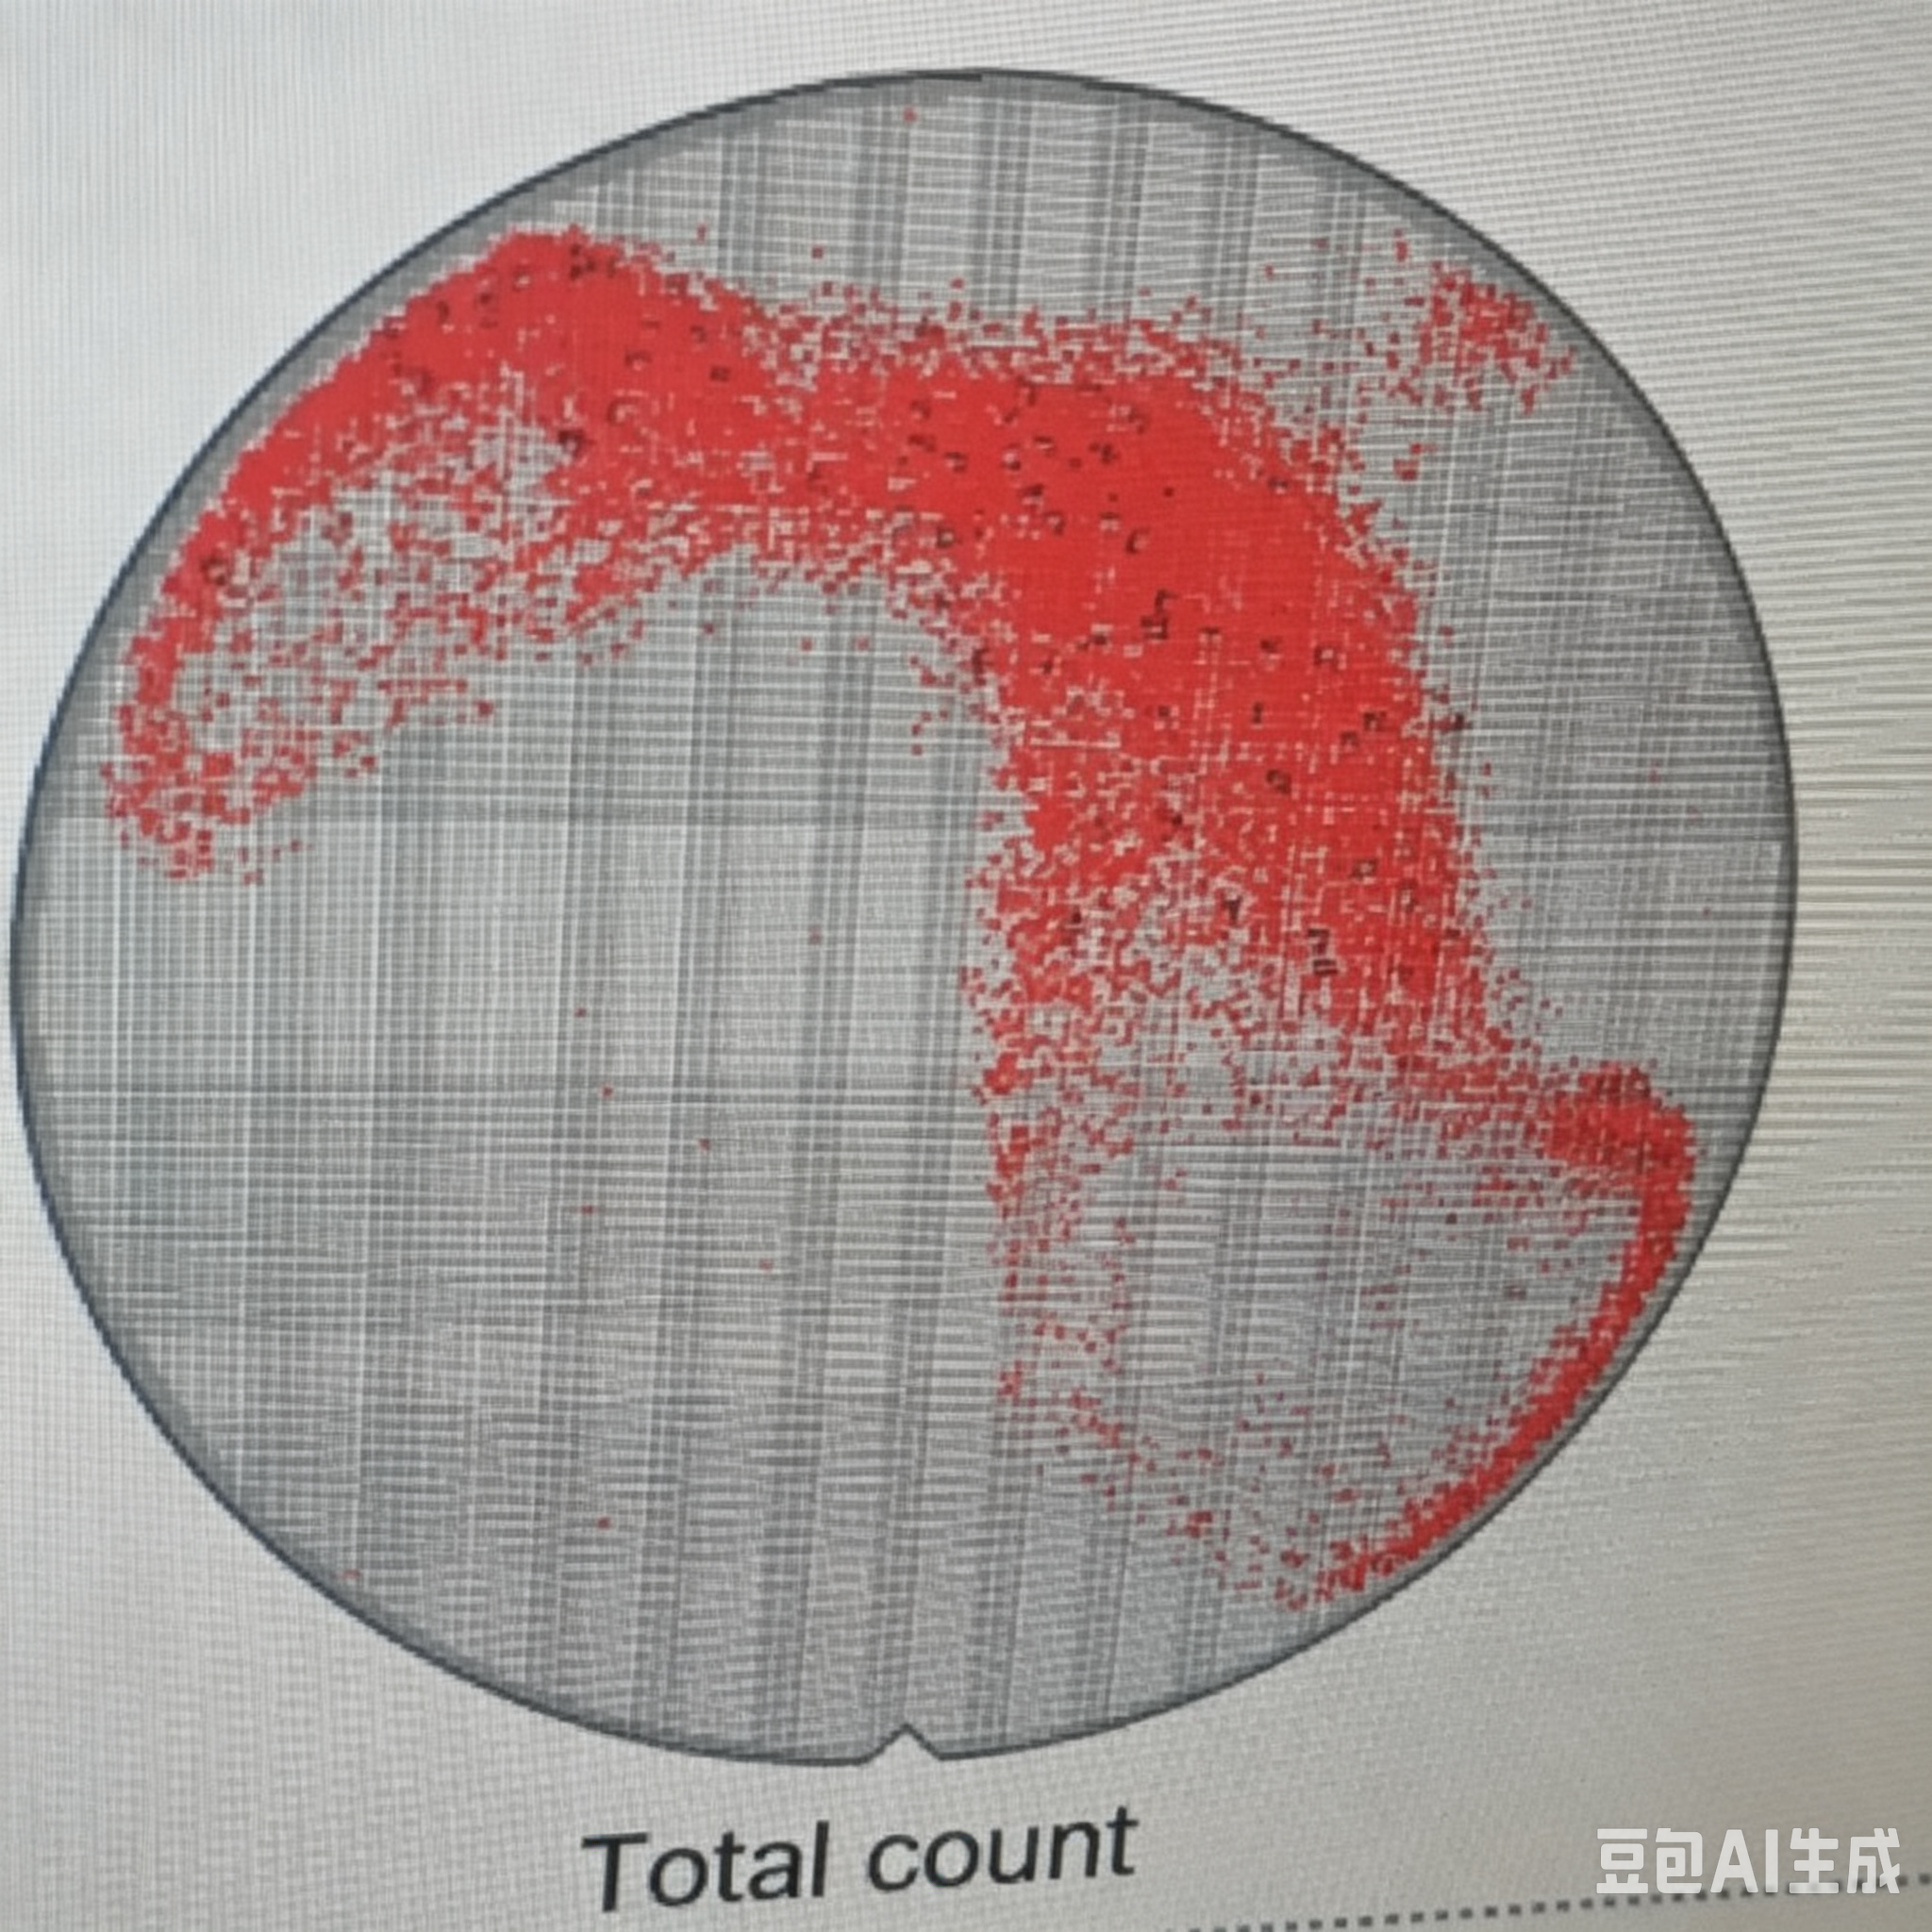
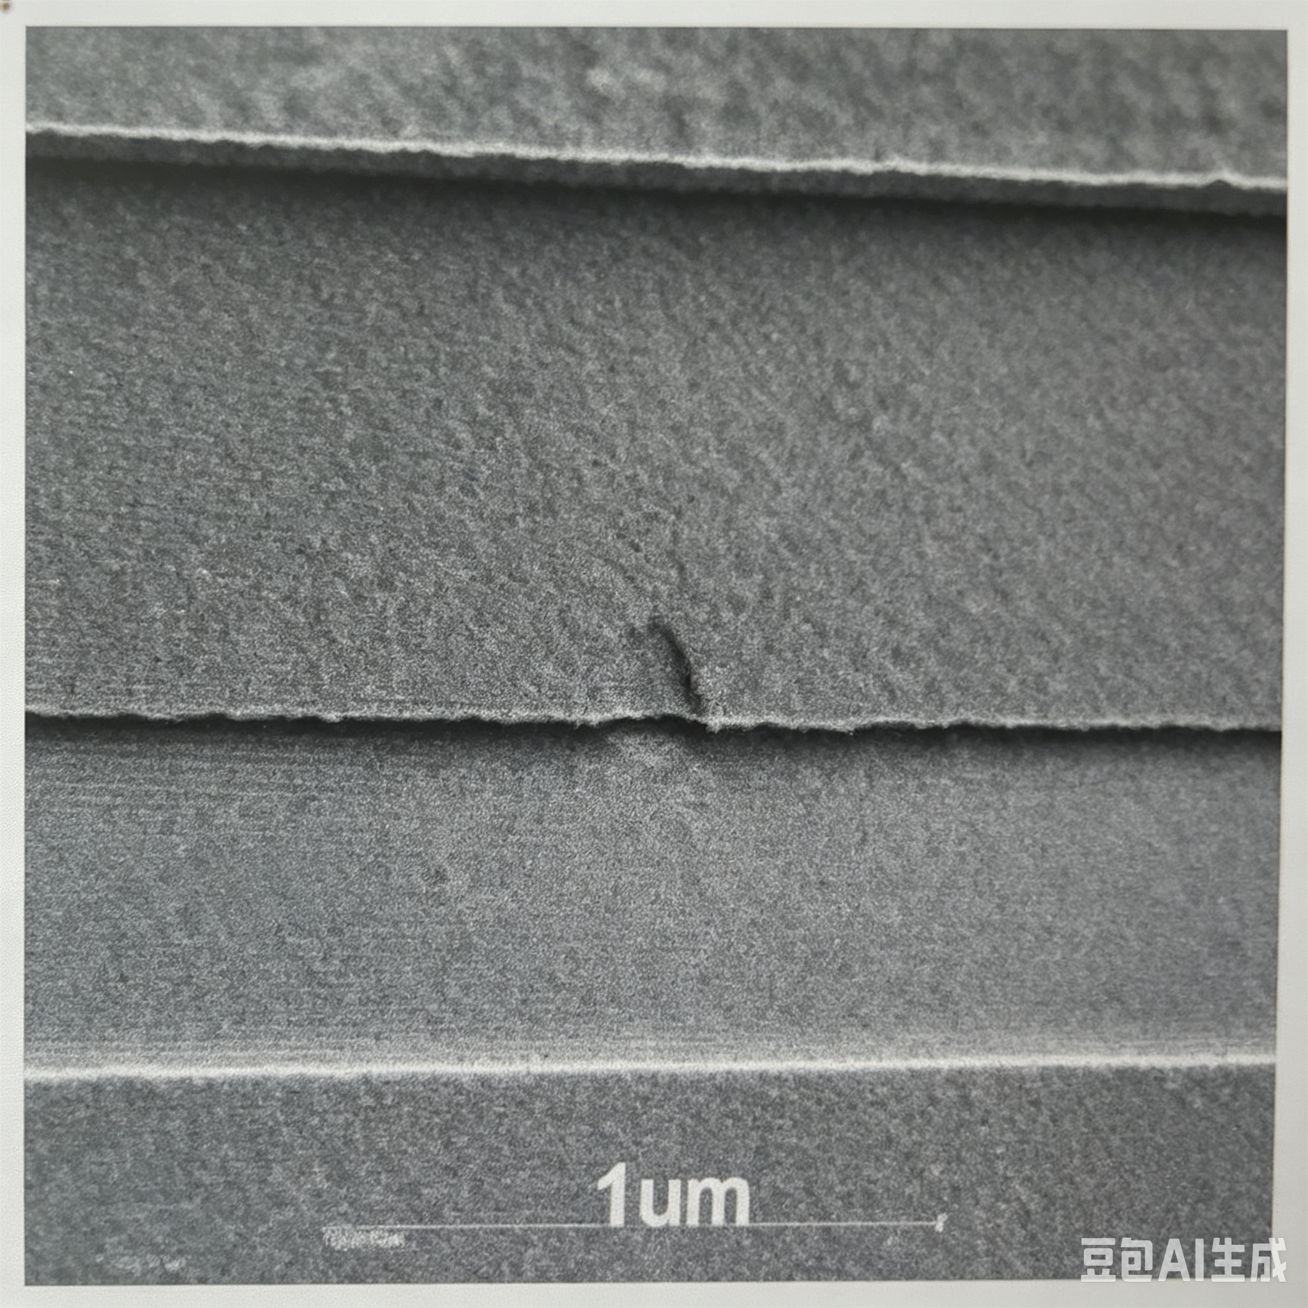
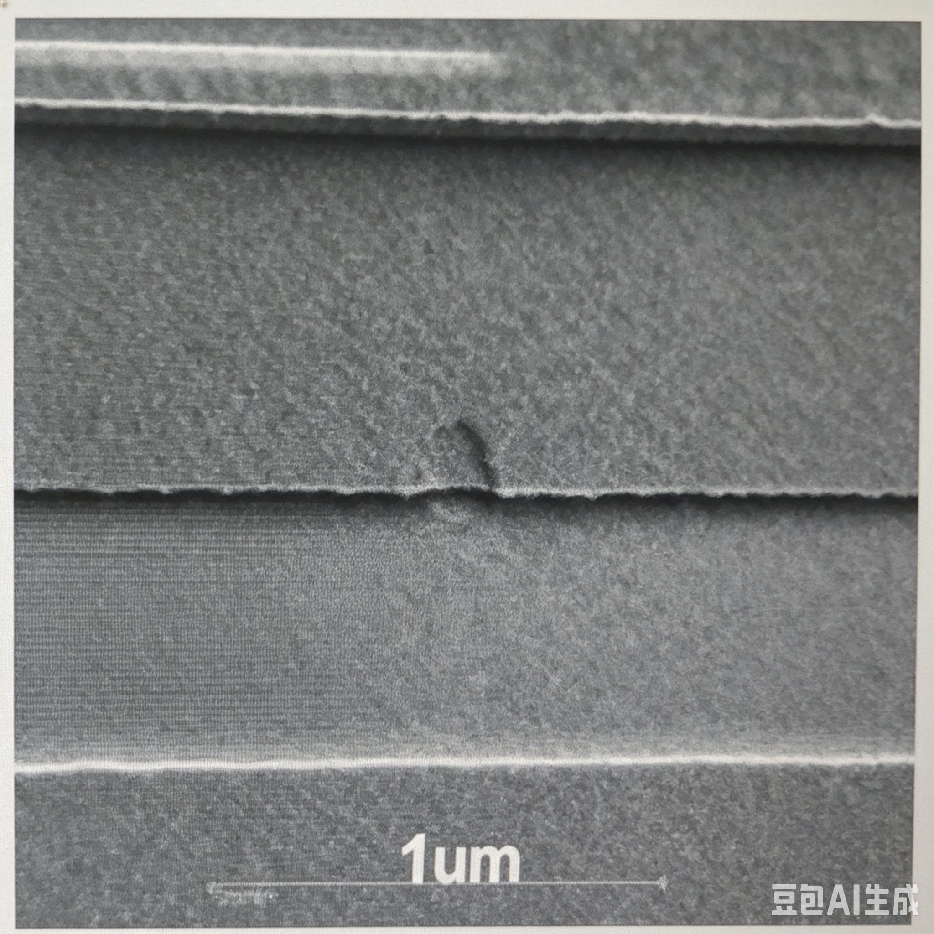
DN-20260517-13 Class2 FP06634 1067_SAB_ASI Pattern_Fail
1.Tech/Product ID/Lot ID/Scan Count:
2.Current Step:
3.Major type/Defect count:
4.Defect distr.Map:
5.Current scan Tool/time/wager
6.Pre-scan stage:
7.Suspected module/EQP ID/Process Time
8.Inform who/date-time:
9.Highlight EQ status:
10.Lots Current Status:
11.Suspected model & Containment Action:
CL040LP/2506/IF95587 NG 04/AdhCANC 25/Total 24
SAB_ASI
#15 Pattern_Fail 100/R800/T98005/N21473 23.25%
Cluster/Center
FLBFIK04 2026/5/17 7:24:48
PEETCH FEASHM13 2026/5/16 3:15:01
liuYanng(1108738)->LiDongShuo(11103042) 2026/5/17 9:10:00
Down
Scrap #1#2#3#6#7#10#11#15

